Slide 1
Pangenomic analysis of M. bovis isolates
PE/PPE genes and their representation in an outbreak
precursor to M. bovis 2020 conference
a presentation by Noah A. Legall

Slide 2
Presentation Outline
Introduction
Pathology
PE & PPE protein family
Michigan USA outbreak
Methods
Pangenomic pipeline
Spades, Prokka, Roary
Results
Future Directions

Slide 3

Introduction
“This was more than just a cow - this was an entire career I was looking at.”
- Gary Larson

Slide 4
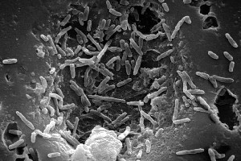
Meet Mycobacterium bovis
Genome size ~ 4,345,492-bp
~3,952 genes
Mainly protein coding
Member of Mycobacterium tuberculosis complex (MTBC)
M. tuberculosis, M. africanum, and M. bovis
99.95% related to M. tuberculosis.
Used as component for M. tuberculosis vaccine – limited efficacy
Worldwide zoonotic disease
Main reservoir: cattle
United Kingdom, New Zealand, and United States of America (Michigan)
200 million cost in New Zealand alone.
Notes:
https://www.newsroom.co.nz/2019/06/25/651872/mbovis-cost-passes-200m#:~:targetText=More%20than%20a%20year%20since,drawn%20from%20a%20budgeted%20contingency.

Slide 5
M. bovis’s stealthy pathology
Respiratory transmission
To hide from immune system, M. bovis gets ingested by macrophage cells.
While in the macrophage, the disease can hijack the cell and beginning the next stage of its life cycle
Notes:
https://www.researchgate.net/figure/PE-PPE-proteins-influence-macrophage-processing-of-Mycobacterium-tuberculosis-Adapted_fig2_273066469

Slide 6
M. bovis’s stealthy pathology
PE & PPE genes are unique to MTBC species and are believed to modulate crucial steps in pathogenesis
Notes:
https://www.researchgate.net/figure/PE-PPE-proteins-influence-macrophage-processing-of-Mycobacterium-tuberculosis-Adapted_fig2_273066469

Slide 7
PE & PPE protein family
Based on the presence of conserved Pro-Glu (PE) and Pro-Pro-Glu (PPE) motifs at the N termini of the proteins
Notes:
Picture:
https://link.springer.com/chapter/10.1007/978-3-030-25381-3_6

Slide 8
PE & PPE protein family
Based on the presence of conserved Pro-Glu (PE) and Pro-Pro-Glu (PPE) motifs at the N termini of the proteins
Notes:
Picture:
https://link.springer.com/chapter/10.1007/978-3-030-25381-3_6

Slide 9
M. bovis in Michigan, USA
One of the places where M. bovis has established in a reservoir (white tail deer).
Prevalence: 2.7 – 3.6%
Multiple different hosts in this region (cattle, elk).
different species immunity - variability in PE & PPE genes?
Notes:
Picture:
https://onlinelibrary.wiley.com/doi/full/10.1111/mec.15061
Prevalance:
https://www.ncbi.nlm.nih.gov/pubmed/15137487

Slide 10
Research Interest
How does M. bovis PE & PPE evolution affect host–pathogen interactions in multiple species?

Slide 11

Methods
“The most beautiful thing we can experience is the mysterious. It is the source of all true art and science.”
- Albert Einstein

Slide 12
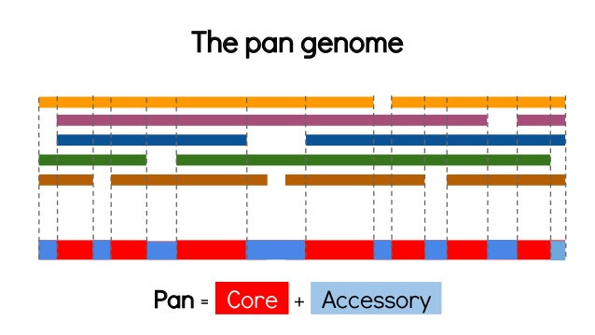
Pan-genomics
The entire gene repertoire of a population of samples (in this case, the samples are from M. bovis).
Will included conserved (core) and variable/unique (accessory) genes
Notes:
https://www.slideshare.net/torstenseemann/comparing-bacterial-isolates-tseemann-imb-winter-school-2016-fri-8-jul-2016

Slide 13
Pangenome Pipeline
I developed a script to perform pangenomics using the following tools:
Spades – Bacterial de novo genome assembly
Prokka – Bacterial genome annotation
Roary – Bacterial pangenome discovery
Notes:
Tools:
https://github.com/ablab/spades
https://github.com/tseemann/prokka
https://sanger-pathogens.github.io/Roary/

Slide 14
Genome assembly
In order to compare the bacterial isolates, we need to reconstruct their genome from sequenced reads
Notes:
Picture: https://en.wikipedia.org/wiki/Genomic_library

Slide 15
De-Novo assembly
Even with a reference available, we are looking for variable genes! Best to just do assembly and compare what is extracted.
FASTQ
Smaller contigs
CONTIG

Slide 16
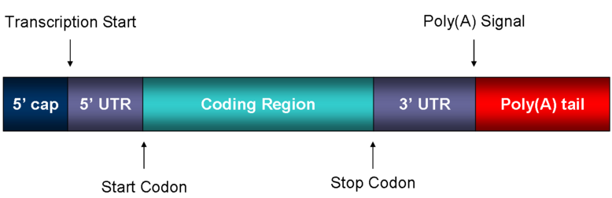
Genome annotation
Once the contigs are assembled, annotate sequences using prokka.
Works by finding CDS, then compares to bacterial protein databases.
Notes:
https://en.wikipedia.org/wiki/Coding_region#/media/File:Mature_mRNA.png

Slide 17
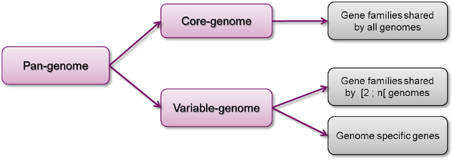
Core and accessory genome separation
Comparing the annotations, we can decipher which genes are shared and which genes are less common amongst isolates. This is done using Roary.
Which of these accessory genes are PE & PPE genes?
Notes:
https://schaechter.asmblog.org/schaechter/2014/06/terms-of-biology-the-pan-genome.html

Slide 18

Results
“I pass with relief from the tossing sea of Cause and Theory to the firm ground of Result and Fact.”
- Winston Churchill

Slide 19
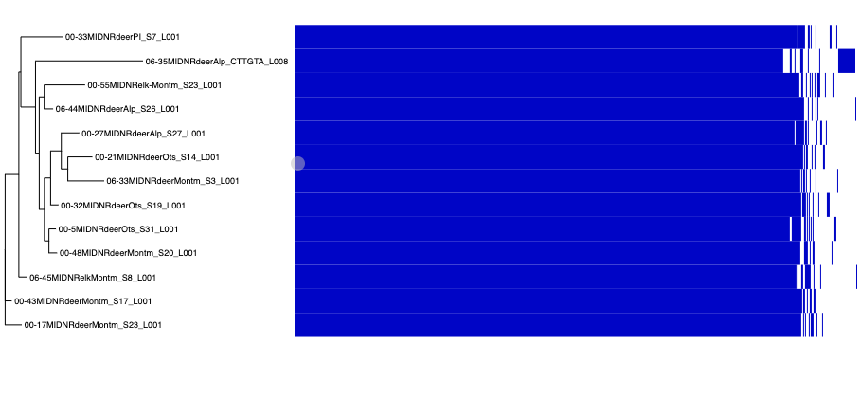
M. bovis has a variable genome

Slide 20
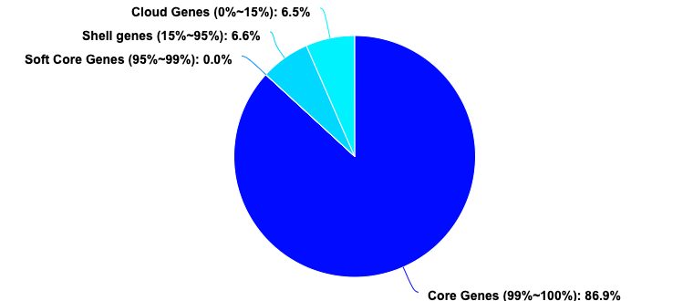
M. bovis pangenome breakdown
Notes:
Test run, 13 isolates from Michigan USA

Slide 21
Accessory contains unknown and PE/PPE genes

Slide 22
PE-PGRS are predominant in the accessory genome

Slide 23

Future Directions
Use of full/larger Michigan dataset
Accessory genome evolution – Bayesian phylogenetic approach
Identify pseudogenes in accessory genome
PE & PPE gene function enrichment in different host species
Other suggestions????

